Slide 1

ANOVA & ANCOVA
Lecture 5
LSM3257
AY22/23; Sem 2 | Ian Z.W. Chan

Slide 2
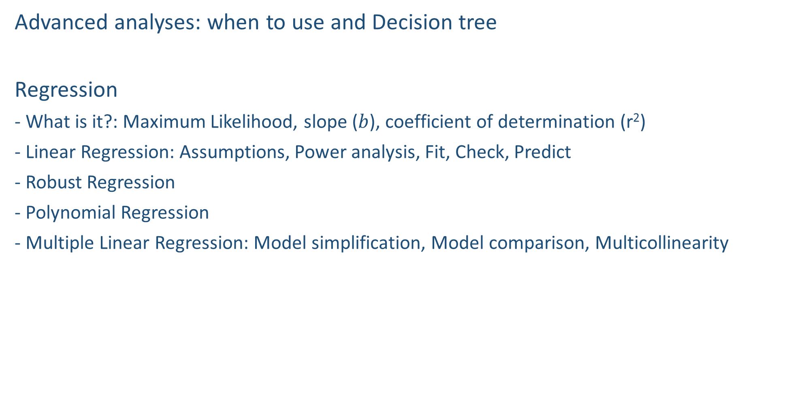
Last week…
Advanced analyses: when to use and Decision tree
Regression
- What is it?: Maximum Likelihood, slope ($b$), coefficient of determination (r²)
- Linear Regression: Assumptions, Power analysis, Fit, Check, Predict
- Robust Regression
- Polynomial Regression
- Multiple Linear Regression: Model simplification, Model comparison, Multicollinearity

Slide 3

Advanced analyses – Analysis decision tree
(will be modified further)
Normally distributed (errors):
Regression
Not normally distributed (errors):
Generalised Linear Model (GLM) with an appropriate error structure
Start
All Continuous
Response variable type
Continuous
Explanatory variables types
All Categorical
KIV
Normally distributed (response):
Analysis of variance (ANOVA)
Not normally distributed (response):
Kruskal-Wallis test
Categorical
Continuous and Categorical
Time to Death
Count
Number of categories
Normally distributed (response):
Analysis of covariance (ANCOVA)
Not normally distributed (response):
Rank-based ANCOVA (RANCOVA) or
GLM with an appropriate error structure
Proportion
2
>2
GLM with Poisson errors (aka Poisson regression)
No
Overdispersion present?
GLM with Binomial errors (aka Binary Logistic regression)
Yes
Survival Analysis
GLM with Binomial errors (aka Logistic regression)
GLM with Quasi-Poisson errors or
GLM with Negative Binomial errors
GLM with Multinomial errors (aka Multinomial Logistic regression)

Slide 4
Summary (Learning Objectives)
Analysis of variance (ANOVA)
- Assumptions, fitting, checking and interpreting
- Alternatives: Welch’s one-way ANOVA, Kruskal-Wallis test
- Repeated measures ANOVA (and Friedman test)
- Factorial vs. Split plot designs
Factorial experiments: 2-way and 3-way ANOVA
Nested ANOVA
Analysis of covariance (ANCOVA)
- Assumptions, fitting, checking and interpreting
- Alternative: Rank-based ANCOVA (RANCOVA)
- Factorial experiments: 2-way and 3-way ANCOVA

Slide 5
ANOVA

Slide 6
What is Analysis of Variance (ANOVA)?
Used when your one response variable is continuous and all your explanatory variables are categorical.
- T-tests can handle only 2 categories of 1 categorical explanatory variable → ANOVA can handle >2 categories and >1 variable.
Partitions the total variance in the dependent variable (SSY) into variance that can be explained by the different levels in explanatory variable A (SSA), explanatory variable B (SSB), etc., and finally the remaining unexplained variance (SSE):
SSY = SSA (+ SSB + SSC …) + SSE
Degrees of freedom = the number of datapoints (i.e. number of levels (k)) x replicates per level (n) – number of levels (k) (because we have to estimate the mean for each level). General formula:
Df = kn – k = k(n – 1)
- Example: if you have 3 levels and 10 replicates per level: df = 3(10 – 1) = 27.

Slide 7
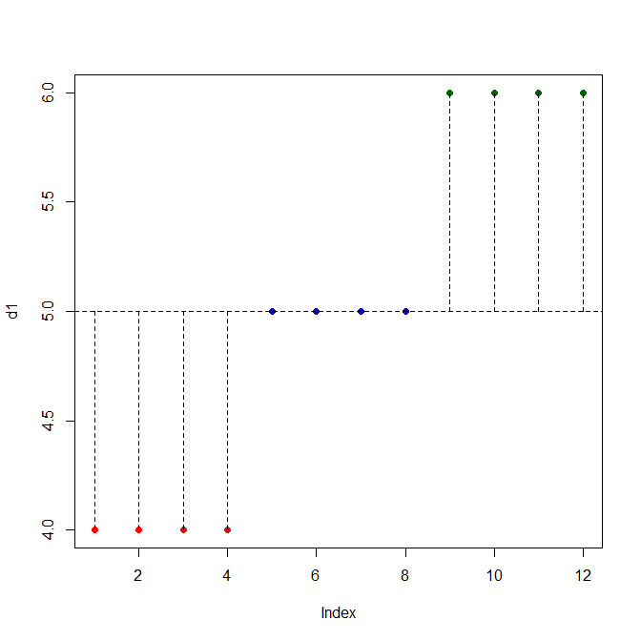
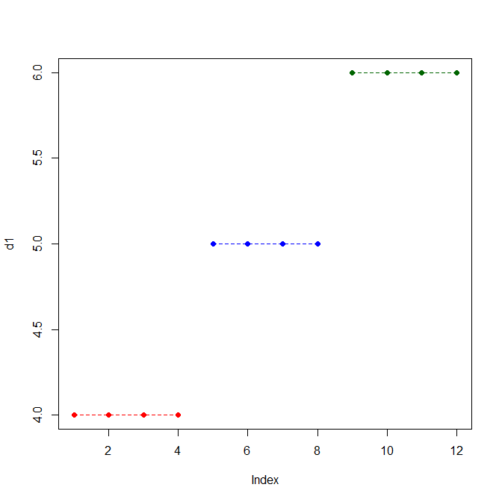
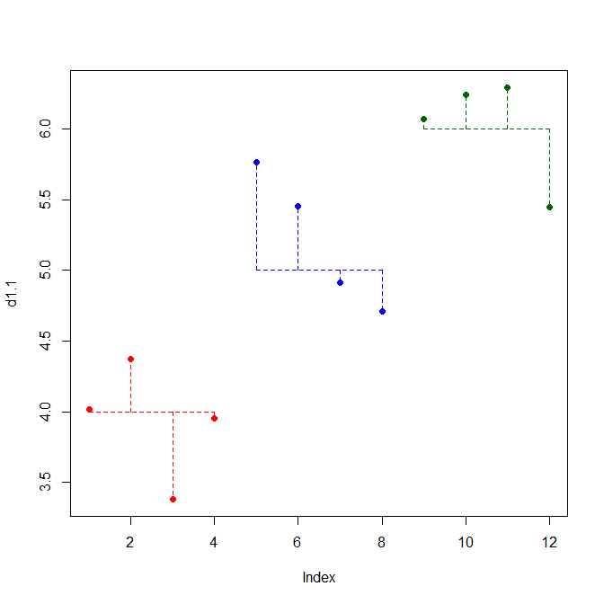
What is Analysis of Variance (ANOVA)?
Explained graphically…
Null Model
ANOVA (1 explanatory variable with 3 levels)
In reality
SSY
SSY = SSA + SSE
(here, SSE = 0)
SSE ≠ 0
Mean

Slide 8
Examples
Continuous response variable
Weight
Biodiversity
Carbon storage potential
Good-looking Index (1 to 1000)
Categorical explanatory variable
Diet: Normal, Drought (2 levels)
Pollution: Absent, Present (2 levels)
Habitat: Forest, Grassland, Tundra (3 levels)
Faculty: Science, Business, Arts (3 levels)

Slide 9
Assumptions
The response variable is normally distributed within each level.
- Check by testing the normality of either (i) the datapoints in each level individually (easy to do if you have few groups; or (ii) the residuals of the model. Both test the same thing.
The variances within each level are equal (i.e. homogeneity or equality of variances).
Each datapoint is independent.
Absence of significant outliers.

Slide 10

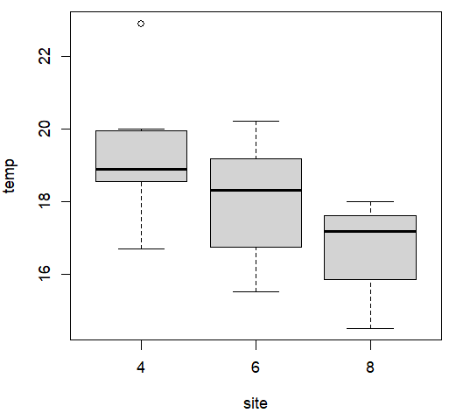

Explore your data
If we run an lm(), R will do a Regression instead of an ANOVA
#Read in and visualise data
d6=read.csv("temperatureData.csv")
str(d6)
#Convert <site> into a factor (because it is a categorical variable)
d6$site=as.factor(d6$site)
levels(d6$site)
#Visualise how <temp> varies with <site>
boxplot(temp~site,data=d6)
Is this outlier important?
No overlap between the boxes of levels 4 and 8, so there is likely a significant difference. We need to do the ANOVA to confirm this.

Slide 11
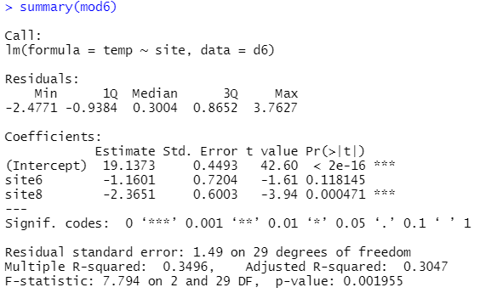
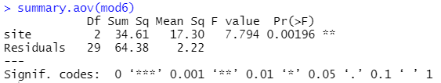
Fitting the ANOVA
Effect sizes: the average of “6” is 1.16 ± 0.72 less than the average of “4”; the average of “8” is 2.37 ± 0.60 less than the average of “4”
Level “8” is significantly different from level “4”. Level “6” is not significantly different from level “4”.
By default, R compares all levels to the first level alphabetically.
#Using either aov() or lm()
mod6=lm(temp~site,data=d6)
summary(mod6)
summary.aov(mod6)
Looks like there’s a significant effect!
Note 1: if you run aov(), then summary() will give you the summary.aov() output instead. To get the output you see above, you will need to call summary.lm().
Note 2: These two commands show you the same results, formatted to show different things. The “summary.lm” results are better for looking at effect sizes at different levels. The “summary.aov” results are better for looking at how the variance is partitioned.
Average <temp> of <site> level “4”
<site> has a significant effect on <temp>
Variation explained by <site> and remaining unexplained. Note that Residuals is greater than <site> (that’s why r² < 0.5), but it’s OK! Our model still helped us to understand the data better.

Slide 12
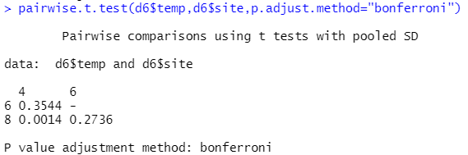
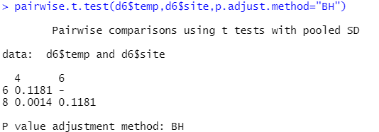
Comparing between groups
Commonly confused for each other…
Pairwise t-tests ≠ Paired t-tests - Pairwise t-tests compare all levels within a categorical variable. - Paired t-tests compare two related groups/datasets.
Do t-tests between all possible pairs of levels
- Remember if we are doing multiple comparisons, we need to correct our p-values. Which of these two corrections is more strict?
pairwise.t.test(d6$temp,d6$site,p.adjust.method="BH")
Alternative: we can use relevel() to change the reference level and re-run the ANOVA. (Very tedious if you have many levels.)
Interpretation: “Average temperatures at site 8 are significantly lower than at site 4 by 2.37 ± 0.6 degrees Celcius (mean ± SE; P < 0.001). There is no significant difference between site 4 and site 6, and between site 6 and site 8.”

Slide 13
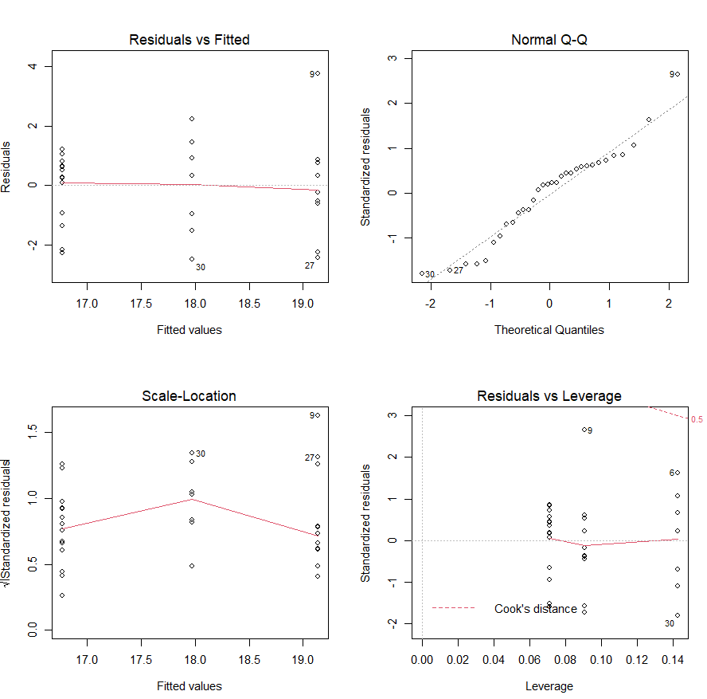
Checking assumptions
#Plot diagnostic plots
par(mfrow=c(2,2))
plot(mod6)
#Test normality of residuals
shapiro.test(resid(mod6))
#Test equality of variance
install.packages("lawstat")
library(lawstat)
levene.test(d6$temp,d6$site)
#p-value > 0.05 is good
Response variable
Explanatory (grouping) variable
Everything looks OK-ish! Buy 4D today!!

Slide 14
If the normality assumption is violated…
Option 1: transform response variable (e.g. log()), then run the ANOVA again and hope for the best.
Option 2: Kruskal-Wallis test (can only handle 1 explanatory variable).
#Global test for all levels
mod2k=kruskal.test(temp~site,data=d6)
mod2k
#Pairwise comparison between all pairs of levels
pairwise.wilcox.test(d6$temp,d6$site,p.adjust.method="BH")
Option 3: Use a GLM with a different error distribution (covered in later lectures).
For kruskal.test() objects, to see the results you have to call the object instead of using summary(). It’s just the way the author wrote it. Alternatively, you can just don’t save it to an object.

Slide 15
If equality of variance is violated…
Option 1: Transform response variable.
Option 2: Welch’s one-way ANOVA.
#Global test for all levels
install.packages("rstatix")
library(rstatix)
welch_anova_test(temp~site,data=d6)
#Here I didn’t save it to an object so the results are displayed automatically.
#Pairwise comparison between all pairs of levels
pairwise.wilcox.test(d6$temp,d6$site,p.adjust.method="BH")
Option 3: Use a GLS or GLM (covered in later lectures).

Slide 16
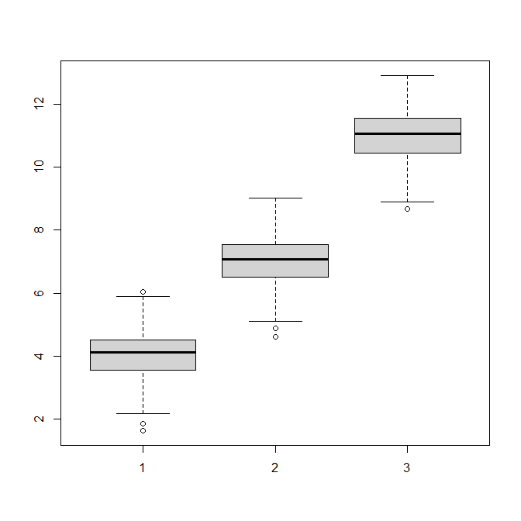

Repeated measures (i.e. “paired”) experiments: Repeated measures ANOVA
Example: you measure the same 25 participants at three time points. The datapoints are not independent, so we cannot do a normal ANOVA.
We need to do a Repeated Measures ANOVA.
#Install the rstatix package
#Load the dataset
d3=read.table("scoreTimes.txt",header=T)
#Run the repeated measures ANOVA
modRM=anova_test(data=d3,dv=score,wid=subject,within=timepoint)
get_anova_table(modRM)
Score
Time 1
Time 2
Time 3
Significant result
Response variable
Dataset
Variable identifying the “paired repeats”
Explanatory variable, to run a 2-way (or more) repeated measures, input the explanatory variables like this: “within=c(variable1,variable2,variable3)”.
This is the result of the Mauchly test of sphericity for the Sphericity assumption (i.e. the variances of the difference between groups should be equal). If they are equal, ges will be close to 1. If ges < 0.75, this test will automatically apply the Greenhouse-Geisser sphericity correction, so you don’t need to worry about it. Just report it.

Slide 17
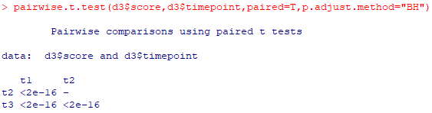
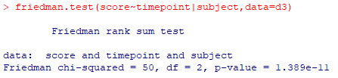
Repeated measures (i.e. “paired”) experiments: Friedman test
#Do pairwise comparisons using paired t-tests
pairwise.t.test(d3$score,d3$timepoint,paired=T,p.adjust.method="BH")
Option 1: transform the y-variable.
Option 2: Use a Friedman test (only available for 1-way)
friedman.test(score~timepoint|subject,data=d3)
Option 3: Use a GLM.
What if the normality assumption is violated?
Variable identifying the “repeats”
Dataset
Response variable
Explanatory variable

Slide 18
Factorial experiments
2 or more categorical explanatory variables, each with 2 or more levels
Continuous response variable
Weight
Biodiversity
Categorical explanatory variables
Diet: Normal, Drought (2 levels)
Sex: Male, Female (2 levels)
(4 unique level combinations)
Country: Singapore, Malaysia, Indonesia
(3 levels)
Pollution: Low, Medium, High (3 levels)
Treatment: A, B, C, D (4 levels)
(36 unique level combinations)

Slide 19
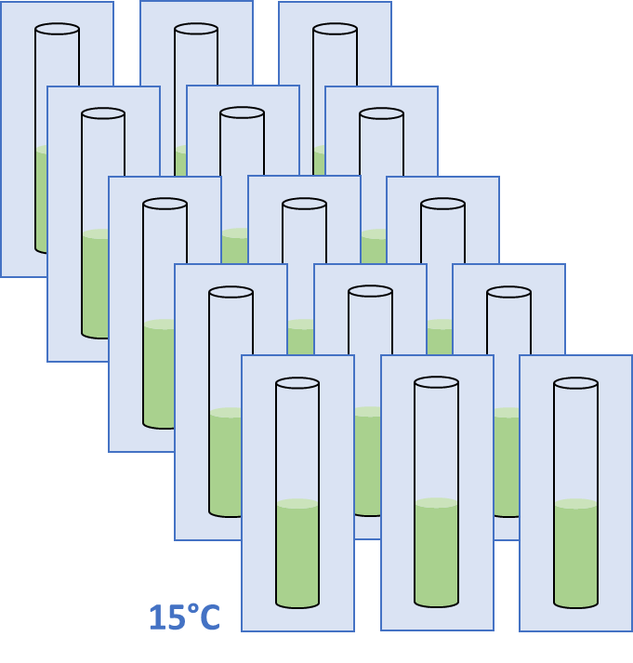
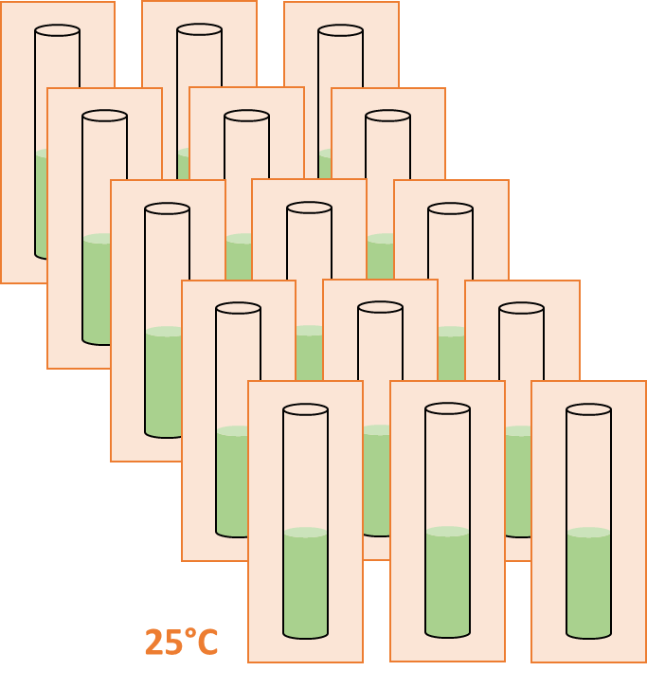
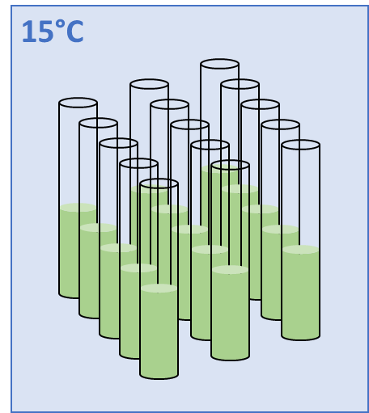
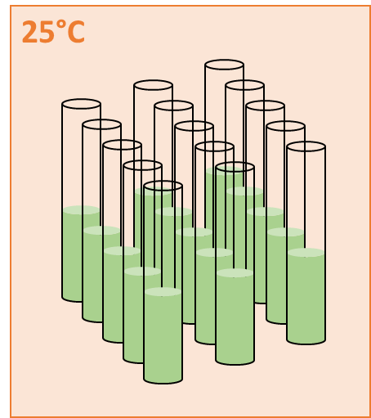
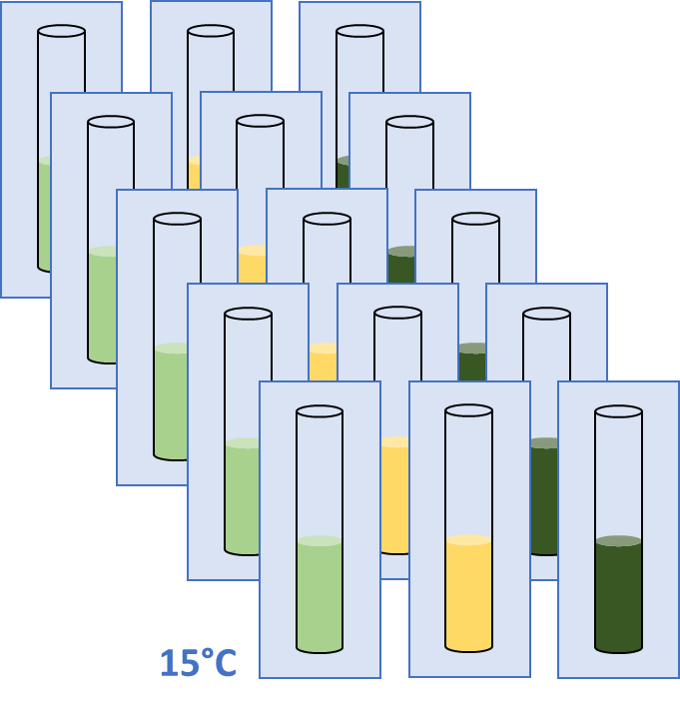
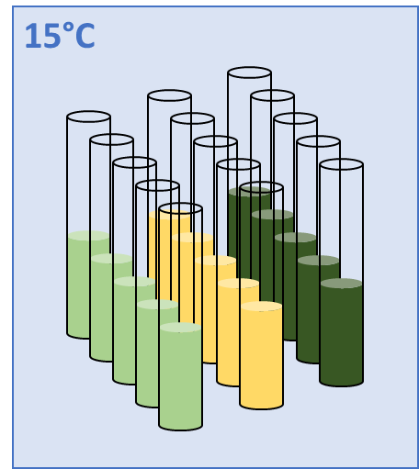
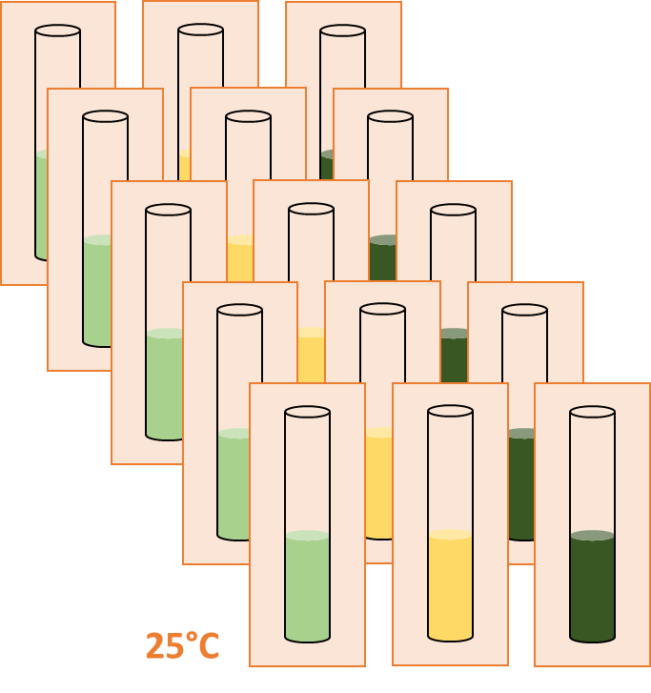
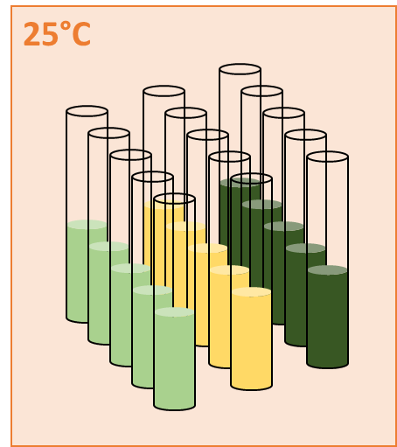
Factorial experiments vs. Split Plot experiments
15°C
Imagine we have 2 categorical explanatory variables
temperature (xvar1): 2 levels (15°C, 25°C)
growthMedium (xvar2): 3 levels (dark green, yellow, light green)
Factorial Split Plot (aka Nested)
25°C
15°C
25°C

Slide 20
Factorial experiments vs. Split Plot experiments
Nutrient level:
Temperature:
1
2
3
A
B
Factorial Split Plot (aka Nested)
Coded in R as: Coded in R as:
y~x1+x2 (or x1*x2) y~x1/x2
B
A
2
1
A
2
A
2
A
A
2
B
B
1
A
2
3
3
3
3
3
B
3
3
B
2
2
2
2
2
B
B
A
2
A
B
3
1
A
2
1
1
1
1
1
1
1
1
A
A
A
B
1
3
3
3
B
B
3
3
3
3
3
3
B
B
B
A
1
3
2
A
2
3
2
2
2
2
2
A
B
A
2
B
3
1
1
1
1
1
1
1

Slide 21
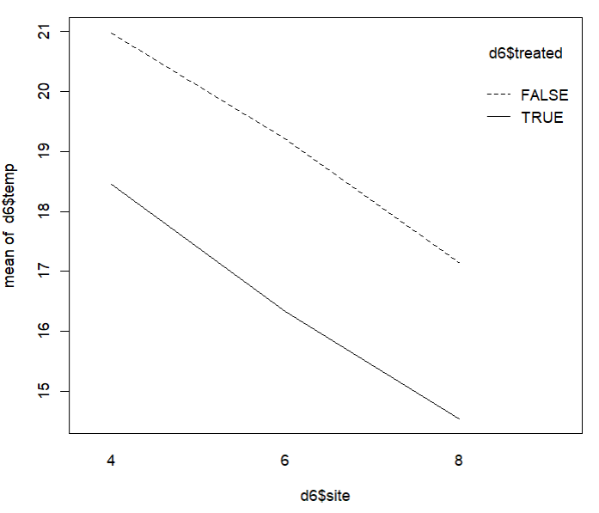
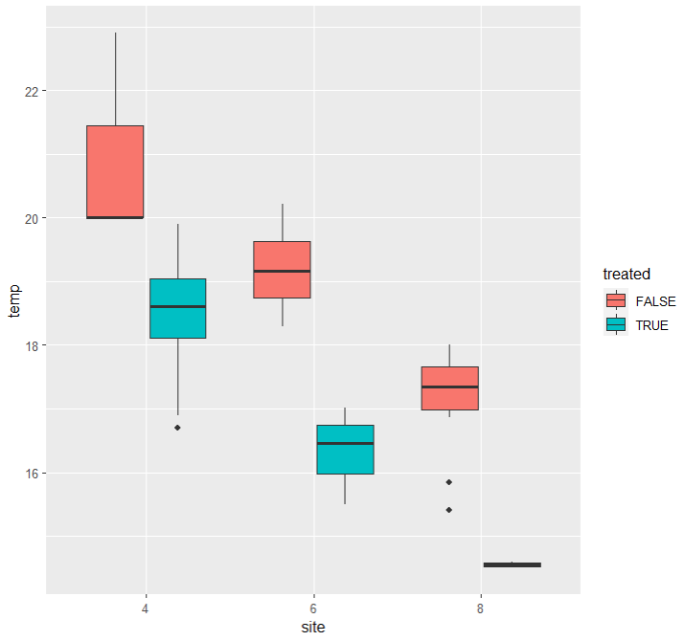
Factorial experiments: 2-way ANOVA
Interaction plot (Base R)
We want to use <site> and <treated> to explain <temp>
- 2 categorical explanatory variables with a factorial design
- We use a 2-way ANOVA
#Visualise: quick (and ugly) plot
interaction.plot(d6$site,d6$treated,d6$temp)
#Visualise: ggplot2
ggplot(d2,aes(x=site,y=temp,fill=treated))+
geom_boxplot()
Doesn’t look like there’s an interaction between cyl and am. If there is an interaction, the two lines would cross (or at least not be parallel).
Ggplot
Main x-axis variable
Secondary explanatory variable
Y-axis variable
Ans
Ans
Ans
Ans
Main x-axis variable
Y-axis variable
Secondary explanatory variable

Slide 22
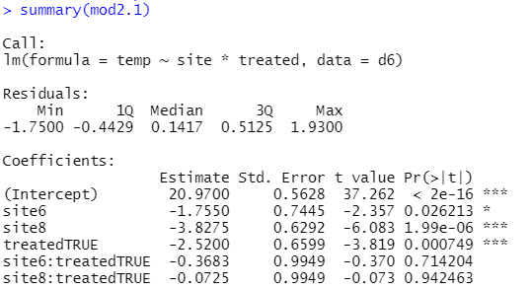
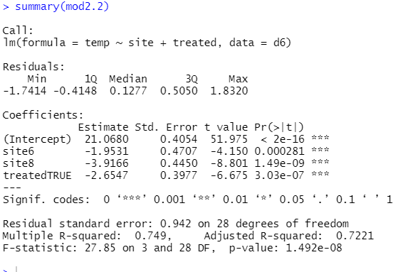
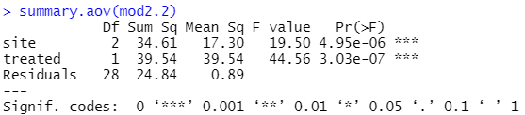
Factorial experiments: 2-way ANOVA
#Run the 2-way ANOVA
mod2.1=lm(temp~site*treated,data=d6)
summary(mod2.1)
#Start with the interaction: no interaction is significant so we can remove it
#Simplify the model
mod2.2=update(mod2.1,~.-site:treated)
summary(mod2.2)
#All significant: looks like we have our minimum adequate model
Notice now that even <site> “6” is significantly different from <site> “4” now (in our 1-way ANOVA before, it was not). Why?
Our model explains more variation than our residuals now. This is great!

Slide 23
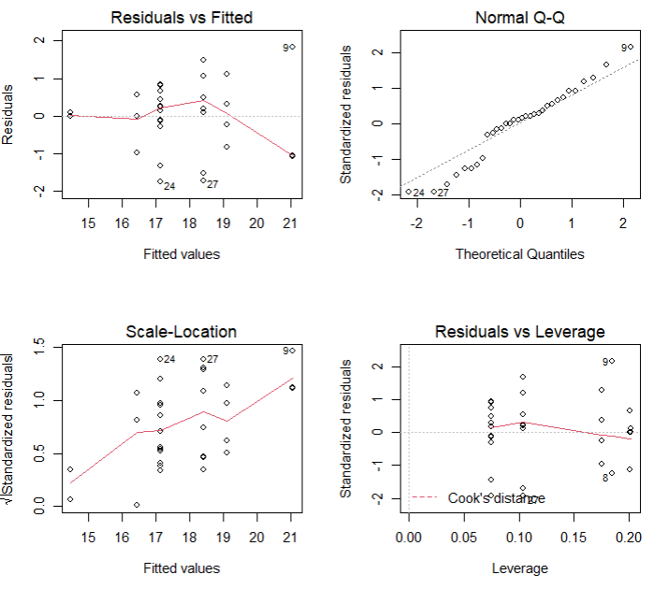
Factorial experiments: 2-way ANOVA
#Always check assumptions!
par(mfrow=c(2,2))
plot(mod2.2)
#Test for normality
shapiro.test(resid(mod2.2)) #p=0.32
#Test for homogeneity of variance
levene.test(d2$temp,gp2.2) #p=0.81
#Note: gp2.2 on next slide
#Everything seems OK
Note: for 2-way (and more) ANOVA, if any of the assumptions are violated, we cannot use Kruskal-Wallis and Welch’s ANOVA. We will need to use a GLM (later lectures).

Slide 24

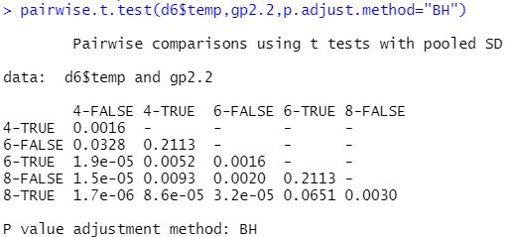
Factorial experiments: 2-way ANOVA
#Pairwise comparisons
gp2.2=paste(d6$site,d6$treated,sep="-")
pairwise.t.test(d6$temp,gp2.2, p.adjust.method="BH")
Interpretation: “Site has a significant effect on temperature. Site 6 is 1.95 ± 0.47 (mean ± SE) degrees cooler than Site 4 (P < 0.001), and Site 8 is 3.92 ± 0.45 degrees cooler than Site 4 (P < 0.001 ). In addition, sites which are treated are 2.65 ± 0.40 degrees cooler than sites that are not treated (P < 0.001).”
This creates a new grouping variable and stores it in “gp2.2”. I am creating this so that I can use it to compare each unique level combination
For each observation, I join the value of <site> (e.g. “6”) to the value of <treated> (e.g. “TRUE”), separated by a hyphen (becomes “6-TRUE”)

Slide 25
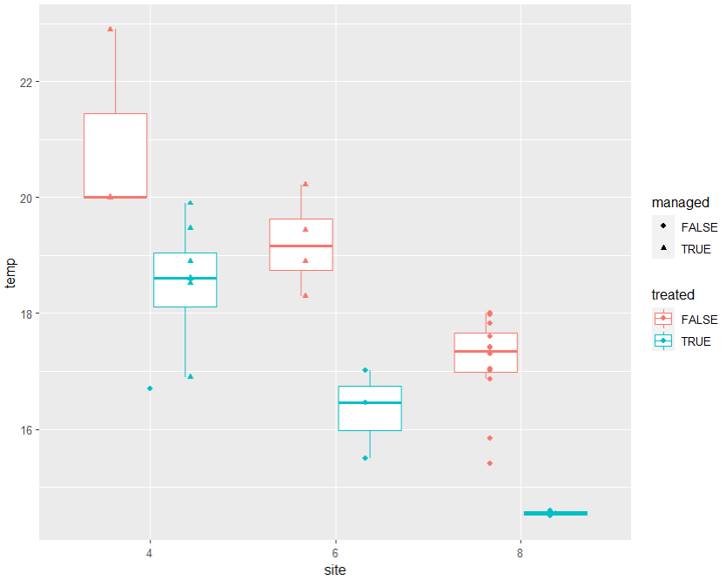
Factorial experiments: 3-way (and more-way) ANOVAs
#To do a 3-way (or more) ANOVA
#Plotting using ggplot
ggplot(d6,aes(x=site,y=temp,col=treated))
+geom_boxplot(outlier.shape=NA)+
geom_point(aes(col=treated,shape=managed), position=position_dodge(width=0.65))
#Fitting the model
mod2.3=lm(temp~site*treated*managed,data=d6)
#Followed by simplification, checking and pairwise testing (if required)
Just keep adding variables to the formula using * or +. But try not to have more than 3 interacting variables, it gets too complicated to explain intuitively (even interpreting the graph, which is supposed to make things easier, becomes difficult!).

Slide 26
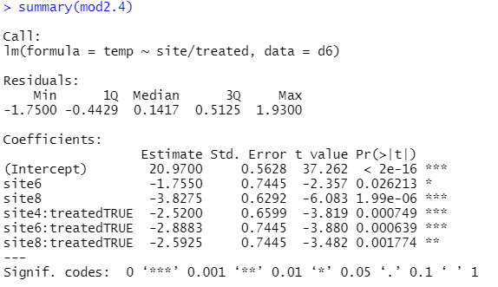
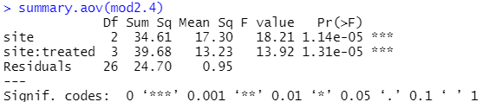
Split Plot experiments: Nested ANOVA
#Assuming <treated> is nested inside <site>
mod2.4=lm(temp~site/treated,data=d6)
Note: We are forcing the model to partition the variation using <site> FIRST, and THEN (within each level of <site>) further partition using <treated>. That’s why there’s no p-value for <treated> on its own. We know this is wrong—that’s why it’s important to know whether your experimental design is Factorial or Split Plot.

Slide 27
ANCOVA

Slide 28
Advanced analyses – Analysis decision tree
(will be modified further)
Normally distributed (errors):
Regression
Not normally distributed (errors):
Generalised Linear Model (GLM) with an appropriate error structure
Start
All Continuous
Response variable type
Continuous
Explanatory variables types
All Categorical
KIV
Normally distributed (response):
Analysis of variance (ANOVA)
Not normally distributed (response):
Kruskal-Wallis test
Categorical
Continuous and Categorical
Time to Death
Count
Number of categories
Normally distributed (response):
Analysis of covariance (ANCOVA)
Not normally distributed (response):
Rank-based ANCOVA (RANCOVA) or
GLM with an appropriate error structure
Proportion
2
>2
GLM with Poisson errors (aka Poisson regression)
No
Overdispersion present?
GLM with Binomial errors (aka Binary Logistic regression)
Yes
Survival Analysis
GLM with Binomial errors (aka Logistic regression)
GLM with Quasi-Poisson errors or
GLM with Negative Binomial errors
GLM with Multinomial errors (aka Multinomial Logistic regression)

Slide 29
What is Analysis of Covariance (ANCOVA)?
Used when your ONE response variable is continuous and you have both continuous and categorical explanatory variables.
ANCOVA is a combination of Regression and ANOVA:
1) It will fit a model between the response variable and the continuous explanatory variable (aka the covariate) for each level of the categorical explanatory variable.
2) It will then give you the intercepts and slopes for each level.

Slide 30
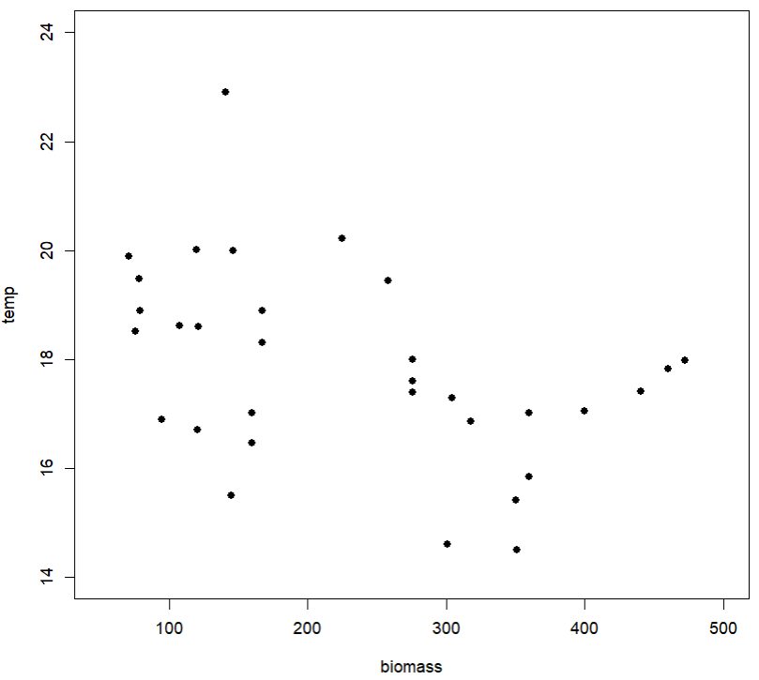
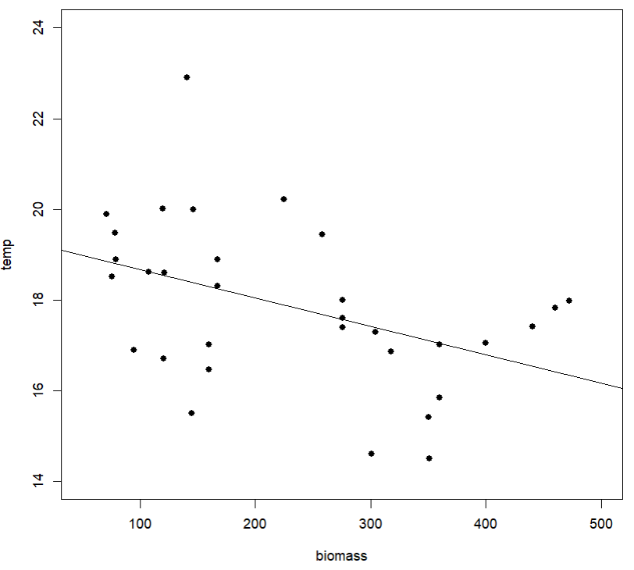
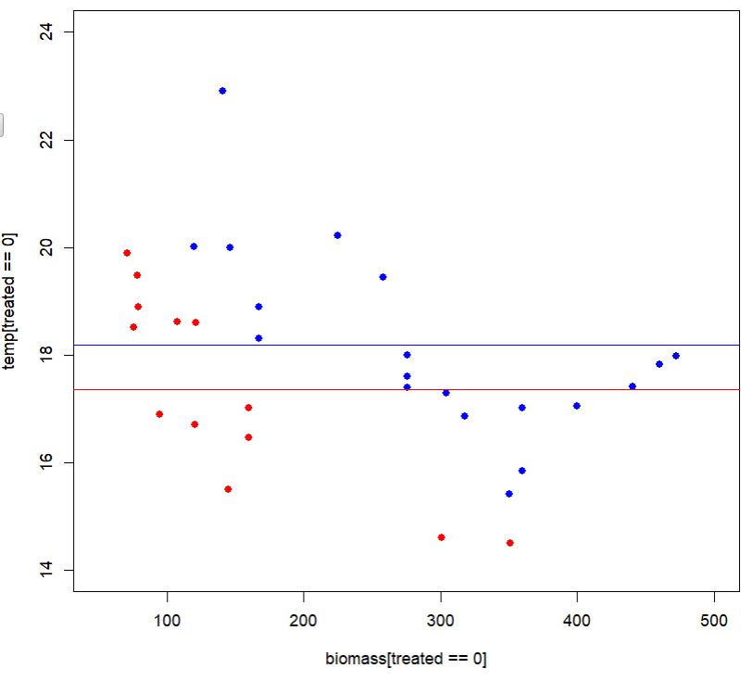
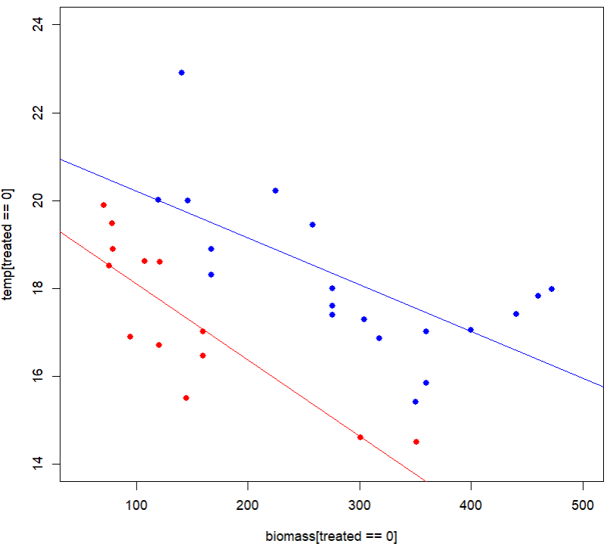
What is Analysis of Covariance (ANCOVA)?
Original data
There is still a lot of overlap between the two levels
The Power of ANCOVA…
Regression alone
ANOVA alone
There is maybe only a very weak negative correlation.
<treated> = FALSE
ANCOVA
<treated> = TRUE
There are different slopes (the regression part)
There are different intercepts (the ANOVA part)
If you do the regression for each level: now there is a very clear negative relationship between <temp> and <biomass>!

Slide 31
Examples
Continuous response variable
Biodiversity
Species population
Explanatory variables
Country: Singapore, Malaysia, Indonesia (categorical – 3 levels)
Biomass: in kg (continuous) [Covariate]
Country: Singapore, Malaysia, Indonesia
(categorical – 3 levels)
Site: A, B, C (categorical – 3 levels)
Biomass: in kg (continuous) [Covariate]
1-way ANCOVA
2-way ANCOVA

Slide 32
Assumptions (same as ANOVA)
The response variable is normally distributed within each level.
Check by testing the normality of either (i) the datapoints in each level individually (easy to do if you have few groups; or (ii) the residuals of the model. Both test the same thing.
The variances within each level are equal (i.e. equality of variances).
Each datapoint is independent.
Absence of significant outliers.

Slide 33
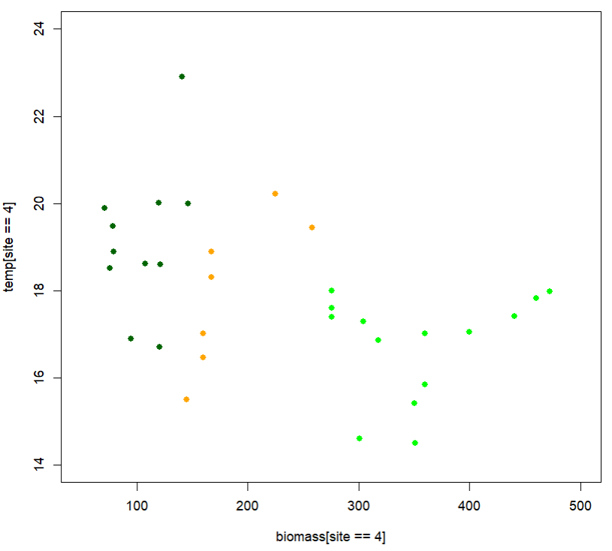
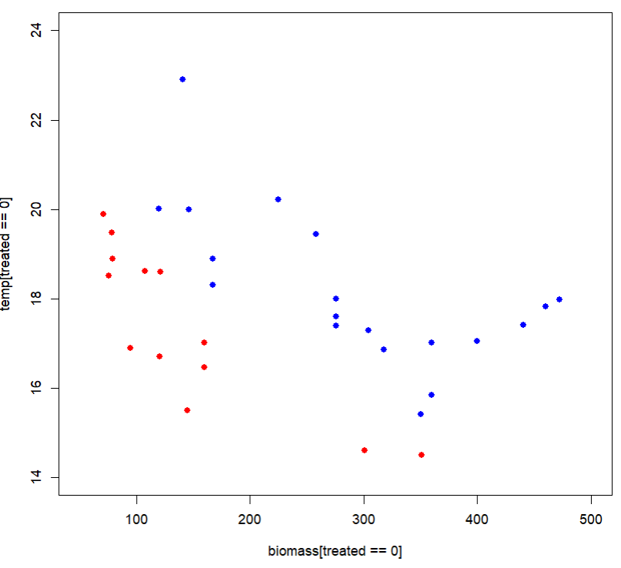
Explore your data
We want to see whether <site> or <treated> can make sense of the relation between <temp> and <biomass>.
#Plot <temp> against <biomass>, by the levels of <site>
plot(temp[site==4]~biomass[site==4],data=d6,pch=16, col="darkgreen",xlim=c(50,500),ylim=c(14,24))
points(temp[site==6]~biomass[site==6],data=d6,pch=16,col="orange")
points(temp[site==8]~biomass[site==8],data=d6,pch=16,col="green")
#Plot <temp> against <biomass>, by the levels of <treated>
plot(temp[treated==0]~biomass[treated==0],data=d6,pch=16,col="blue",xlim=c(50,500),ylim=c(14,24))
points(temp[treated==1]~biomass[treated==1],data=d6,pch=16,col="red")
It looks like both reveal hidden structure in the dataset but <treated> is more straightforward to interpret.
<site> = 4
<site> = 6
<site> = 8
<treated> = FALSE
<Treated> = TRUE

Slide 34
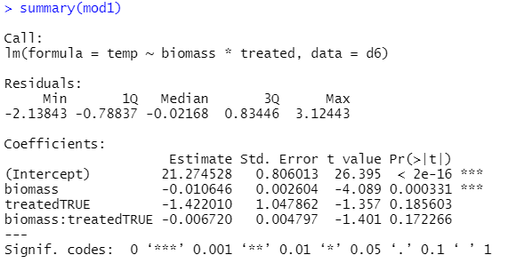
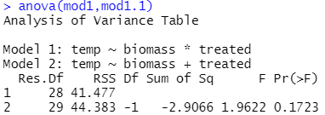
Fit the ANCOVA
Debugging Time!
Can you spot the error in this slide?
#Run an ANCOVA with <biomass> and <treated>, allowing them to interact
mod1=lm(temp~biomass*treated,data=d6)
summary(mod1)
#interaction is non-significant
#Simplify by stepwise deletion
mod1.1=update(mod1,.-biomass:treated)
#Compare the 2 models using anova()
anova(mod1,mod1.1)
#There is no significant reduction in predictive power (P > 0.05), so we prefer the simpler model (i.e. mod1.1, without the interaction term).
Notes:
”mod1.1=update(mod1,~.-biomass:treated)” instead of ”mod1.1=update(mod1,.-biomass:treated)” (missing a tilde)

Slide 35
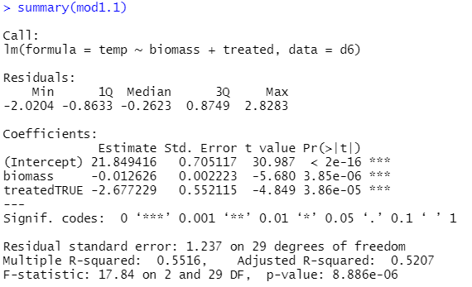
View the results
#Summary
summary(mod1.1)
#Both significant: looks like our final model
#Check assumptions
par(mfrow=c(2,2))
plot(mod1.1)
#All look good!
Interpretation: “Both treated (P < 0.001) and biomass (P < 0.001) have significant effects on temperature. Temperature decreases by 0.01 ± 0.002 degrees Celsius (mean ± SE) for every 1kg increase in biomass. Specimens that have been treated are on average 2.68 ± 0.55 degrees Celsius cooler than those that have not.”

Slide 36
What if residuals are not normal?
Option 1: Transform your variable(s).
Option 2: Use rANCOVA (by Thomas Forstner).
#Define the function and run the test
rancova=function(y,cov1,treatment){
ry=rank(y)
rcov1=rank(cov1)
e=lm(ry~rcov1)$residuals
m=aov(e~treatment)
summary(m)
}
rancova(y=d6$temp,cov1=d6$biomass,treatment=d6$treated)
Option 3: use a GLM (later lectures).
Function if you want to test 2 covariates
rancova=function(y,cov1,cov2,treatment){
ry=rank(y)
rcov1=rank(cov1)
rcov2=rank(cov2)
e=lm(ry~rcov1+cov2)$residuals
m=aov(e~treatment)
summary(m)
}
rancova(y=d6$temp,cov1=d6$biomass,cov2=d6$numSen,treatment=d2$treated)
Note: at the moment, it’s not possible to test multiple categorical x-variables.
Continuous x-variable (covariate)
Categorical x-variable

Slide 37
What if equality of variance is violated?
Option 1: Transform response variable.
Option 2: Use GLS or a GLM (later lectures).

Slide 38
2-way ANCOVA with 1 covariate
#Explaining <temp> using (i) <biomass> (covariate) and (ii) <treated> interacting with <site>
mod4=lm(temp~biomass+treated*site,data=d6)
#If we think <biomass> may also interact with one of the other variables
mod4=lm(temp~biomass*treated*site,data=d6)
#Explaining <temp> using <numSen> and <biomass> (covariates); <treated>, <site> and <managed>; and two 2-way interactions between <managed>:<treated> and <managed>:<site> only
mod5=lm(temp~numSen+biomass+treated+site+managed+managed:treated+managed:site,data=d6)
3-way ANCOVA with 2 covariates

Slide 39

Tis’ the time to…

Slide 40
Summary (Learning Objectives)
Analysis of variance (ANOVA)
- Assumptions, fitting, checking and interpreting
- Alternatives: Welch’s one-way ANOVA, Kruskal-Wallis test
- Repeated measures ANOVA (and Friedman test)
- Factorial vs. Split plot designs
Factorial experiments: 2-way and 3-way ANOVA
Nested ANOVA
Analysis of covariance (ANCOVA)
- Assumptions, fitting, checking and interpreting
- Alternative: Rank-based ANCOVA (RANCOVA)
- Factorial experiments: 2-way and 3-way ANCOVA

Slide 41
Advanced analyses – Analysis decision tree
(will be modified further)
Normally distributed (errors):
Regression
Not normally distributed (errors):
Generalised Linear Model (GLM) with an appropriate error structure
Start
All Continuous
Response variable type
Continuous
Explanatory variables types
All Categorical
KIV
Normally distributed (response):
Analysis of variance (ANOVA)
Not normally distributed (response):
Kruskal-Wallis test
Categorical
Continuous and Categorical
Time to Death
Count
Number of categories
Normally distributed (response):
Analysis of covariance (ANCOVA)
Not normally distributed (response):
Rank-based ANCOVA (RANCOVA) or
GLM with an appropriate error structure
Proportion
2
>2
GLM with Poisson errors (aka Poisson regression)
KIV
No
Overdispersion present?
GLM with Binomial errors (aka Binary Logistic regression)
Yes
Survival Analysis
GLM with Binomial errors (aka Logistic regression)
GLM with Quasi-Poisson errors or
GLM with Negative Binomial errors
GLM with Multinomial errors (aka Multinomial Logistic regression)

